Slide 1
Week 3 : Introduction to Programming
Python
Tuesday, June 20th

Slide 2
REVIEW
Python as a Calculator
+, -, * ,
/ division- always returns a floating point number
() grouping
//floor division
** raising to power
% remainder of the division
_ the last printed expression
r’ raw string
Types
int
float
str
list
Tuples
Dict
Concatenation
Slicing
Mutability
Index-able
Lookup
Initialization
Common functions
input()
type()
len()
Check out more built in functions at Python’s official documentation.

Slide 3
REVIEW
Order of operations
Type conversion e.g. using str() or int()

Slide 4
Conditionals

Slide 5
Boolean Expressions
A Boolean expression is an expression that is either true or false. Created using comparison operators such as:
x == y # x is equal to y
x != y # x is not equal to y
x > y # x is greater than y
x < y # x is less than y
x >= y # x is greater than or equal to y
x <= y # x is less than or equal to y

Slide 6
Logical Operators
There are three logical operators : and , or , and not
x > 0 and x < 10 is true only if x is 1,2,3,4,5,6,7,8, or 9.
n%2 == 0 or n%3 == 0 is true if number is divisible by 2 or 3.
the not operator negates a boolean expression, so not(x > y) is true if (x > y) is false, that is, if x is less than or equal to y
In Python any nonzero number is interpreted as true e.g.
>>> x = 5
>>> x and 1
1
>>> y = 0
>>> y and 1
0

Slide 7
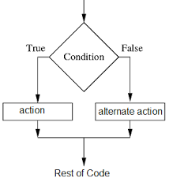
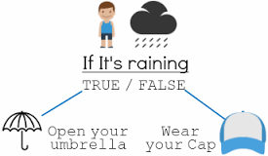
Conditionals

Slide 8
Example

Slide 9
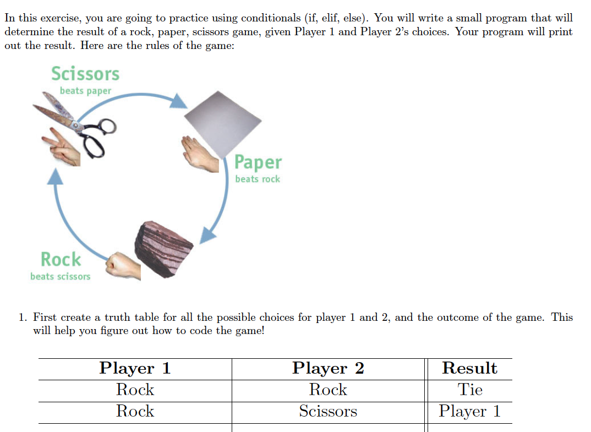
Rock Paper Scissors

Slide 10
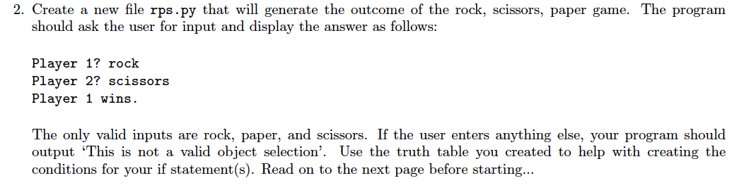
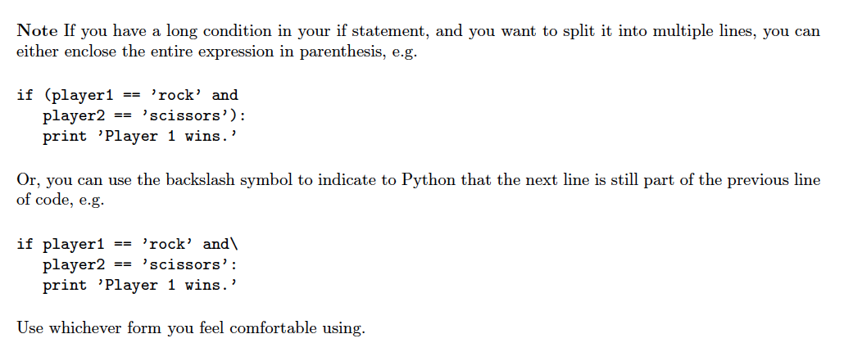
Rock Paper Scissors

Slide 11
Loops

Slide 12
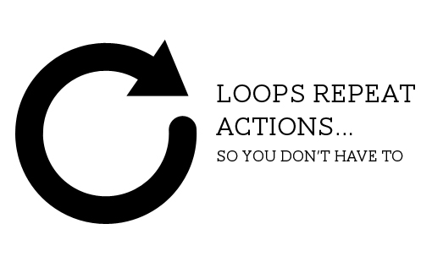
Loops
Source:http://www.onlineteachinghub.com/

Slide 13
Loops
Recall the fibonacci:
>>> fibonacci_list = [1,1]
>>> fibonacci_list.append(fibonacci_list[-1]+fibonacci_list[-2])
>>> print(fibonacci_list)
[1, 1, 2]
>>> fibonacci_list.append(fibonacci_list[-1]+fibonacci_list[-2])
>>> print(fibonacci_list)
[1, 1, 2, 3]
>>> fibonacci_list.append(fibonacci_list[-1]+fibonacci_list[-2])
>>> print(fibonacci_list)
[1, 1, 2, 3, 5]

Slide 14
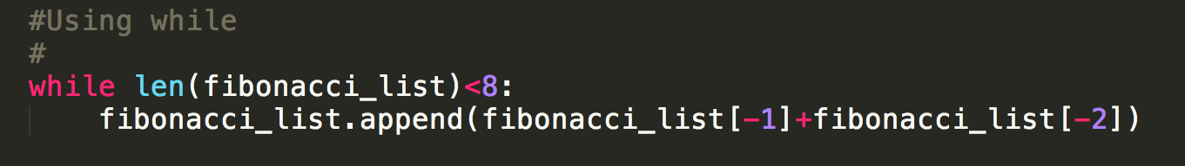
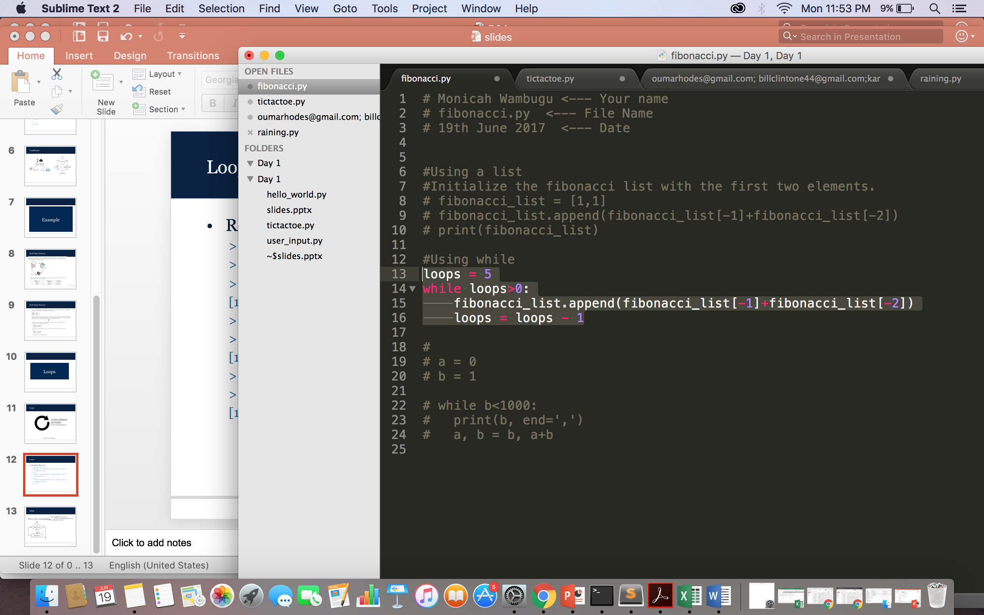
While loop
Notes:
What is the stop condition for each of these?

Slide 15
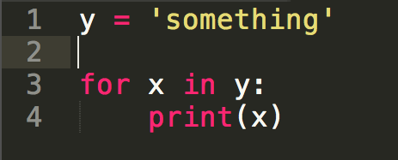
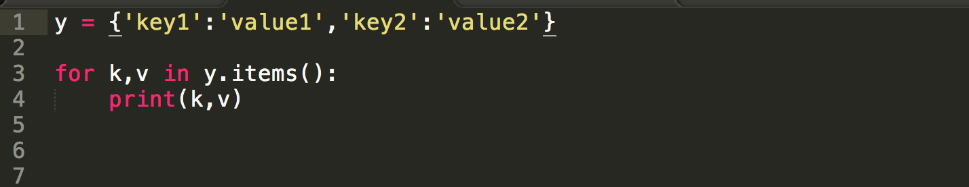
For Loop
A for loop can be used to traverse elements in a list, a string, a tuple and a dictionary
Exercise: Write a python program that prints out the square for every item in a list
Dictionaries allow you to unpack the items in a dictionary as shown:

Slide 16
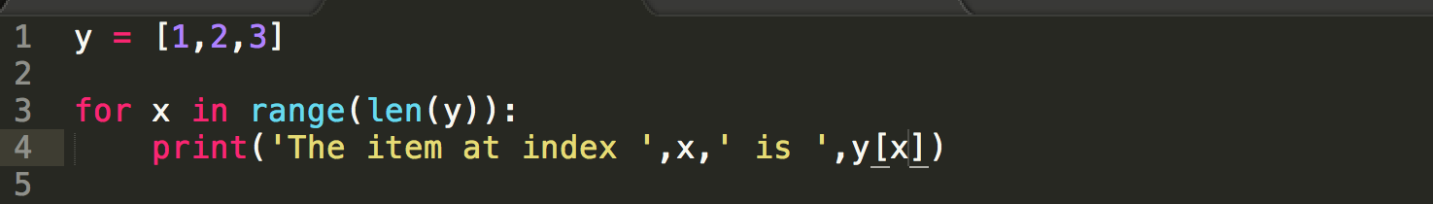
For loop
range(stop)
range(start, stop[, step])
This function is commonly used with for loops to specify the arithmetic progression. In Python 3, range can be cast into a list using list()
>>> list(range(10))
[0, 1, 2, 3, 4, 5, 6, 7, 8, 9]
>>> list(range(2, 10))
[2, 3, 4, 5, 6, 7, 8, 9]
>>> list(range(1, 10, 2))
[1, 3, 5, 7, 9]
The item at index 0 is 1
The item at index 1 is 2
The item at index 2 is 3

Slide 17
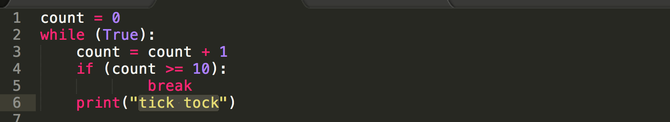
Break
Breaks out of the smallest enclosing for or while loop.”
NB: Always ensure you have a well defined stop condition to ensure you don’t loop forever!!

Slide 18
Loop Exercises
1. Using a for loop, write a program that prints out the decimal equivalents of 1= 2; 1= 3; 1= 4; : : : ; 1= 10.
2. Write a program using a while loop that asks the user for a number, and prints a countdown from that number to zero. What should your program do if the user inputs a negative number? As a programmer, you should always consider edge conditions" like these when you program! (Another way to put it- always assume the users of your program will be trying to find a way to break it! If you don't include a condition that catches negative numbers, what will your program do?)
Notes:
http://pythoncentral.io/pythons-range-function-explained/

Slide 19
Loop Exercises
3. Write a program using a for loop that calculates exponentials. Your program should ask the user for a base and an exponent exp , and calculate base^exp.
4. Write a program using a while loop that asks the user to enter a number that is divisible by 2. Give the user a witty message if they enter something that is not divisible by 2- and make them enter a new number . Don't let them stop until they enter an even number! Print a congratulatory message when they finally get it right.
Notes:
http://pythoncentral.io/pythons-range-function-explained/

